Slide 1

FOR PARENTS
You stay in charge.
What your child experiences, what you see, and how your family's data is treated.
MyTutor · with Mr. Cadabra · mrcadabra.com
Notes:
If you're a parent looking at yet another math app, here are the three things you actually want to know: what your child experiences, what you get to see, and how your family's data is treated. Let's take them in order.

Slide 2
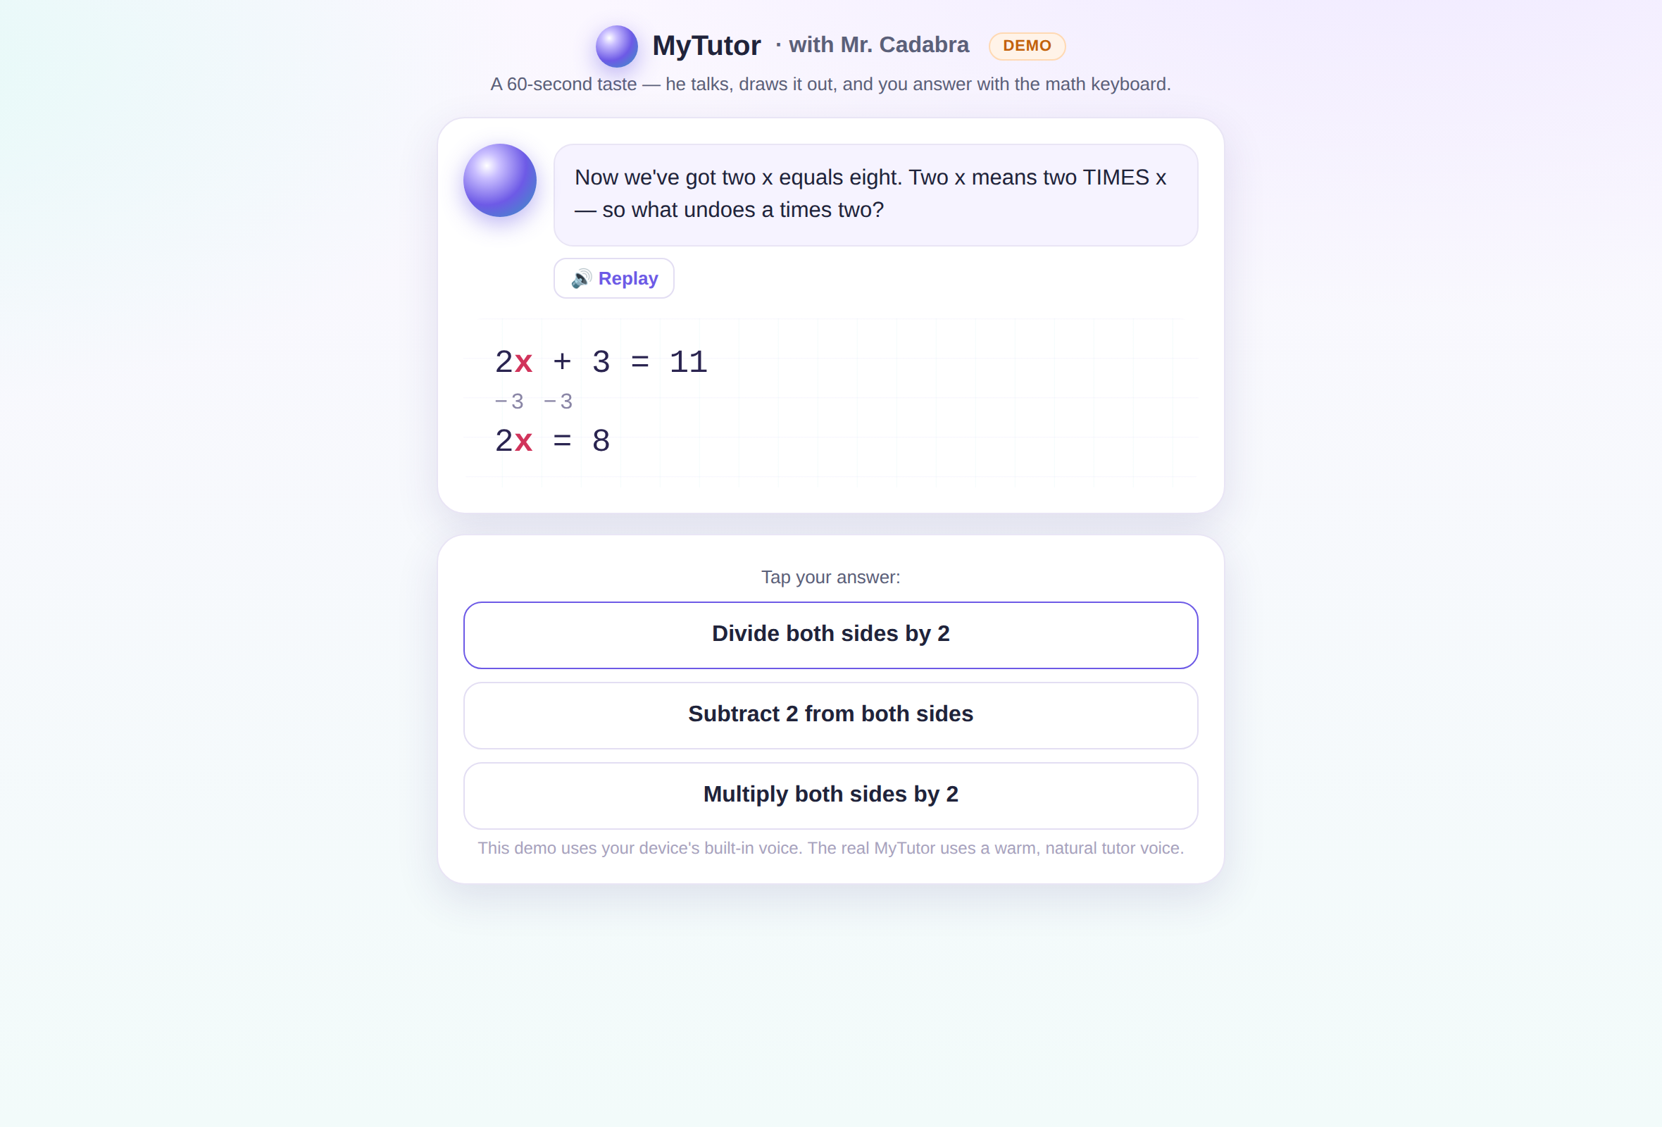
A tutor that teaches — never just answers.
Mr. Cadabra explains out loud, draws each step, and asks the next question instead of handing over the answer. He's math-only and won't be talked off topic — kids do try.
Notes:
First, what your child experiences. Mr. Cadabra teaches the way a good human tutor does — he explains out loud, draws every step, and asks the next question instead of just giving the answer. And he stays on task: math only, no matter how creatively your kid tries to change the subject.

Slide 3
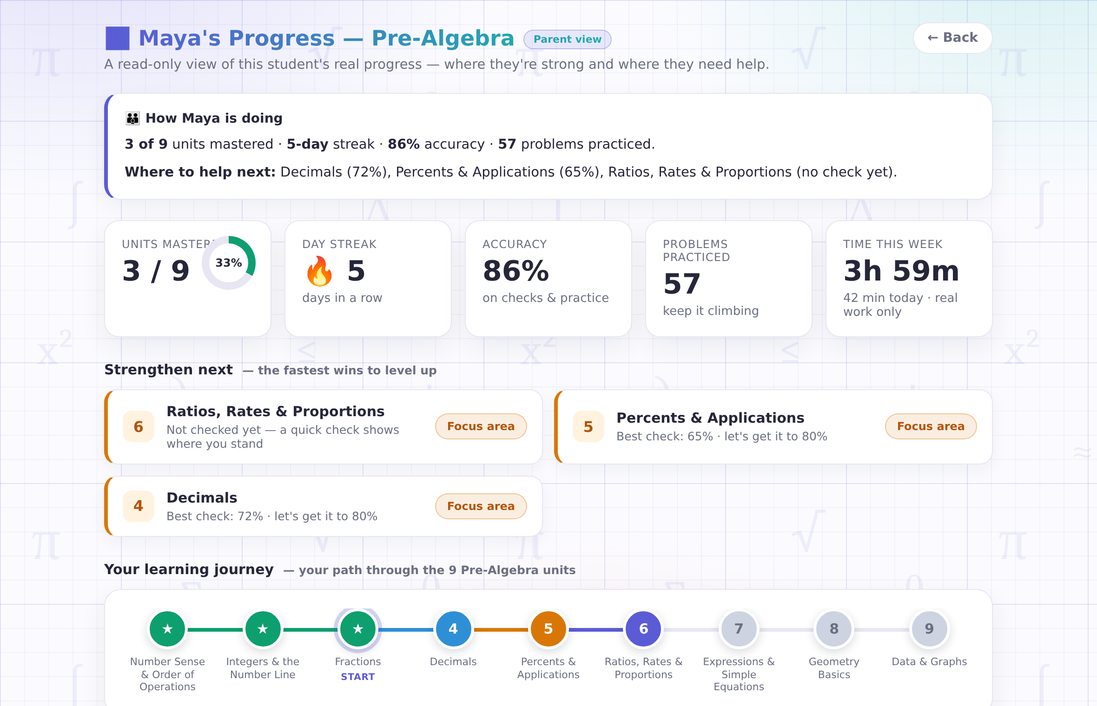
Your own window in.
Your parent code opens a read-only dashboard: how they're doing, where to help next, and real scores from real checks — never invented numbers.
Notes:
Second, what you see. Your own parent code opens a read-only view of your child's real progress — what's mastered, what's slipping, and most useful of all, where to help next. Every number comes from an actual scored check. Nothing is invented.

Slide 4
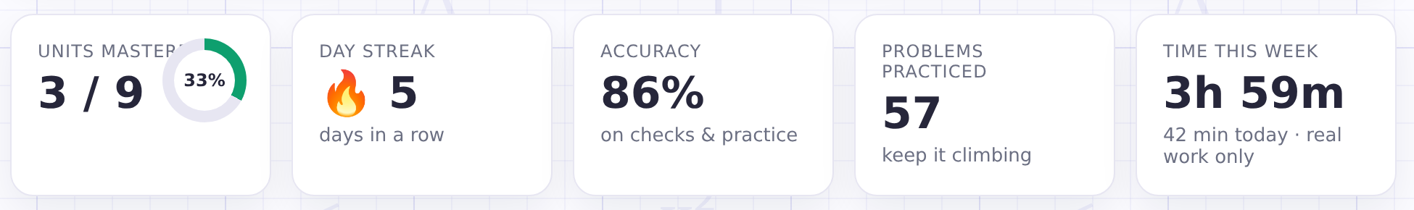
Honest time, honest numbers.
A minute counts only when your child is actually working — walk away or switch tabs and the clock stops. "42 minutes today" means 42 minutes of math.
Notes:
We even track time honestly. A minute only counts when your child is actually working — if they walk away or switch tabs, the clock stops. So when the dashboard says forty-two minutes today, that's forty-two minutes of real math. A weekly progress email is included with every plan at launch.

Slide 5
Privacy promises we can keep.
🔇
🚫
🔑
No microphone, ever
Never sold, no ads
You hold the keys
The tutor talks; your child types. No student voice is recorded or sent anywhere.
We never sell student data. No email, phone, photos, or location asked of children.
You get the codes, you see the dashboard, and one email deletes your child's data.
Notes:
And third — your family's data. There's no microphone, ever: the tutor talks and your child types, so no student voice is recorded. We never sell student data and show no ads. And you hold the keys — you control the account, and one email deletes everything. These are privacy promises we can actually keep.

Slide 6
Try it before your child does.
The two-minute sample lesson tells you everything.
mrcadabra.com/demo
Notes:
The fastest way to judge MyTutor is to try it yourself — the sample lesson takes two minutes and there's no sign-up. Visit mrcadabra.com, and if you have a question, a real person answers the email.

